Slide 1
Chapter 11,12 Congress
Congressional Powers

Slide 2
Chap 11, 12 Vocabulary
1.Expressed powers
2. Implied powers
3. Inherent powers
4. Necessary and Proper Clause
5. Impeach
6. Censure
7. Speaker of the House
8. President of the Senate
9. President pro tempore
10. Pocket veto
11. Committee chairman
12. Veto
13. Seniority rule
14. Standing Committee
15. Select Committee
16. Joint Committee
17. Conference Committee
18. Bill
19. Rider
20. Discharge petition
21. Subcommittee
22. Filibuster
23. cloture

Slide 3
Congressional Power
The Constitution grants Congress a number of specific powers in three different ways:
The expressed powers are granted to Congress explicitly in the Constitution.
The implied powers are granted by reasonable deduction from the expressed powers.
The inherent powers are granted through the Constitution’s creation of a National Government for the United States. The power to regulate immigration is an example of an inherent power.

Slide 4
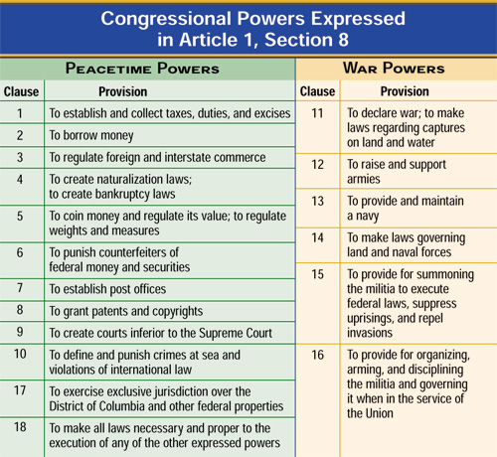
Article I, Section 8
Congressional powers expressed in Article 1, Section 8

Slide 5
The Necessary and Proper Clause
The Necessary and Proper Clause gives to Congress the power:
“To make all Laws which shall be necessary and proper for carrying into Execution the foregoing Powers and all other Powers vested by this Constitution in the Government of the United States, or in any Department or Officer thereof.”
— Article I, Section 8, Clause 18

Slide 6
The Battle Over Implied Powers
The formation of the Bank of the United States spawned controversy.
In McCulloch v. Maryland, 1819, the formation of the Second Bank of the United States was challenged by opponents.
Chief Justice John Marshall ruled in favor of the Second Bank and the Federal Government, giving sweeping approval to the concept of implied powers.

Slide 7
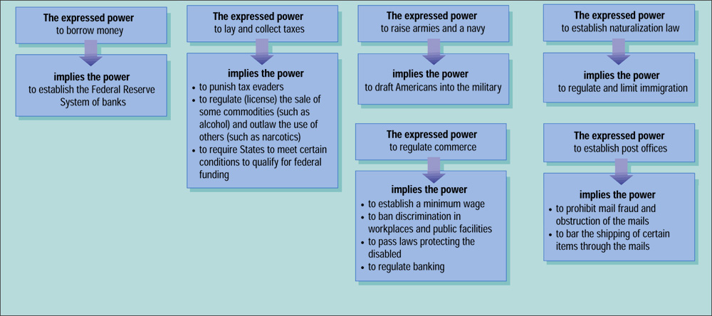
The Implied Powers of Congress

Slide 8
Impeachment Power
The Constitution grants Congress the power of removing the President, Vice President, or other civil officers from their office through impeachment.
The House has the sole power to impeach, or bring charges against the individual. A majority vote in the House is required for impeachment.
There is then a trial in the Senate. A two-thirds vote of the senators present is needed for conviction which results in removal from office.

Slide 9
Congress Convenes*
Congress convenes every two years — on January 3 of every odd-numbered year.
The House has formal organizational meetings at the beginning of each term to determine committee membership and standing officers.
The Senate, because it is a continuous body, has fewer organizational issues to address at the start of each term.
When Congress is organized, the President presents a State of the Union message to a joint session of Congress. This message, in which the President reports on the state of the nation as he sees it, is given annually and is required by the Constitution.

Slide 10
The Presiding Officers
The Speaker of the House
The Speaker of the House is the presiding officer of the House of Representatives and the acknowledged leader of the majority party.
The Speaker’s main duties revolve around presiding over and keeping order in the House.
The Speaker names the members of all select and conference committees, and signs all bills and resolutions passed by the House.
The President of the Senate
The Constitution designates the Vice President as president of the Senate and can only vote to break a tie.
The president pro tempore, is normally the longest serving senator from the majority party.
The real power in the Senate rests with the Senate Majority Leader.

Slide 14
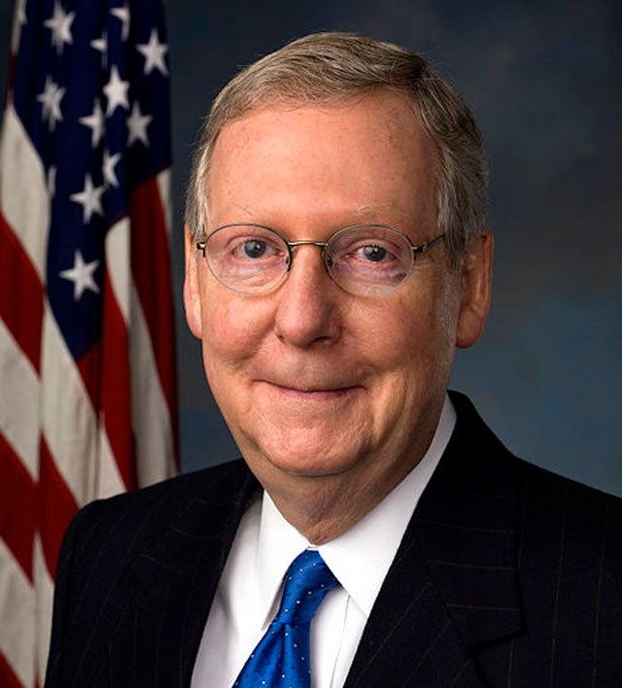
Minority Leader
Mitch McConnell

Slide 15
Committee Chairmen and Seniority Rule
Committee Chairmen
The committee chairmen are the members who head the standing committees in each chamber of Congress.
Seniority Rule
The head of each committee is most often the longest-serving member of the committee from the majority party.

Slide 16
Standing Committees
Standing committees are permanent panels in Congress to which bills of similar nature can be sent.
Most of the standing committees handle bills dealing with particular policy matters, such as veterans’ affairs or foreign relations.
The majority party always holds a majority of the seats on each committee.

Slide 17
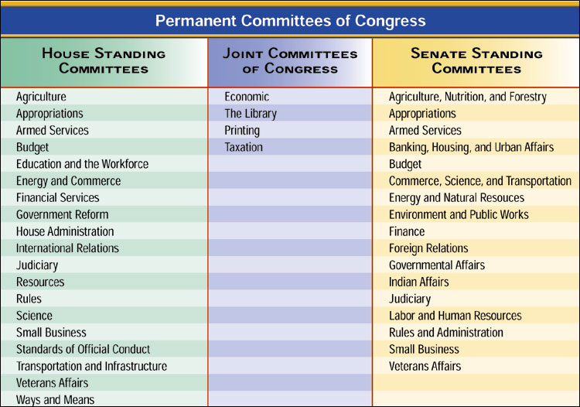
Permanent Committees of Congress

Slide 18
Joint and Conference Committees
A joint committee is one composed of members of both houses.
Examples of joint committees include the Joint Economic Committee, the Joint Committee on Printing, and the Joint Committee on the Library of Congress
A conference committee—a temporary, joint body—is created to iron out differences between bills passed by the House and Senate before they are sent to the President.

Slide 19
Permanent Committees of Congress

Slide 20
The House Rules Committee and Select Committees
The House Rules Committee
The Rules Committee decides whether and under what conditions the full House will consider a measure.
This places great power in the Rules Committee, as it can speed, delay, or even prevent House action on a measure.
The Select Committees
Select committees are panels established to handle a specific matter and usually exist for a limited time.
Most select committees are formed to investigate a current matter.

Slide 21
The Bill in Committee
Discharge Petitions
Most bills die in committee, pigeonholed, or put away, never to be acted upon.
If a committee pigeonholes a bill that a majority of the House wishes to consider, it can be brought out of committee via a discharge petition.
Gathering Information
Most committees do their work through several subcommittees— divisions of existing committees formed to address specific issues.

Slide 22
Voting on a Bill
There are four methods of taking a floor vote in the House:
During voice votes the Speaker calls for the “ayes” and then the “noes.”
In a standing vote, members in favor of for and then those opposed to the bill rise and then are counted by the clerk.
One fifth of a quorum can demand a teller vote, in which the Speaker names two tellers, for and against, and members pass by each one to be counted.
A roll-call vote may be demanded by one fifth of the members present.

Slide 23
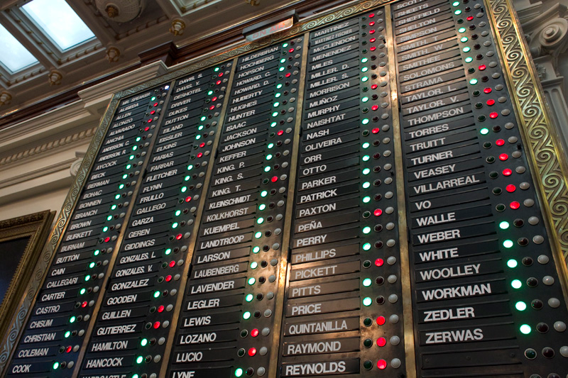

Slide 24
Introducing a Bill and Rules for Debate in the Senate
Introducing a Bill
Bills are introduced by senators, who are formally recognized for that purpose.
Proceedings are much less formal in the Senate compared to the House.
Rules for Debate
The major differences between House and Senate rules regard debate over measures.
As a general matter, senators may speak on the floor for as long as they wish.
This freedom of debate allows for the fullest possible discussion of matters on the floor.

Slide 25
Filibuster and Cloture *
Filibuster
A filibuster is an attempt to “talk a bill to death” or not vote on a confirmation.
Longest filibuster was 24 hours, 18 minutes.
A senator may exercise his or her right of holding the floor as long as necessary, and in essence talk until a measure is dropped.
The Cloture Rule
Rule XXII in the Standing Rules of the Senate deals with cloture, or limiting debate
If at least 60 senators vote for cloture, no more than another 30 hours may be spent on debate, forcing a vote on a bill.

Slide 26
Conference Committees
Any measure enacted by Congress must have been passed by both houses in identical form.
If one of the houses will not accept the other’s version of a bill, a conference committee is formed to iron out the differences.
Once a conference committee completes work on a bill, it is returned to both houses for final approval. It must be accepted or rejected without amendment.

Slide 27
The President Acts
The Constitution provides four options for the President when he receives a bill:
The President may sign the bill, and it then becomes law.
The President may veto the bill, or refuse to sign it.
The President’s veto can be overridden by a two-thirds vote of the members present in each house.
If the President does not act upon a bill within 10 days of receiving it, it becomes law.
A pocket veto occurs if Congress adjourns within 10 days of submitting a bill and the President does not sign it. The bill then dies.

Slide 28
Important Questions Chap 11,12
Explain the differences between implied, expressed, and inherent powers.
Explain why President Clinton was NOT removed from office.
Explain how a bill becomes a law.
Who are the Leaders of each house (Speaker, pro tempore, Majority Minority Leaders and whips)

