Slide 2
Chapter 5,6,7 U.S. Government
Chap 5 (pg 116-123;134-135;
140-142.
Chap 6 (pg 164-172)
Chap 7 (pg 178-186;196-202)

Slide 3
What Is a Party?
A political party is a group of persons who seek to control government by winning elections and holding office. The American parties are election-oriented.
The two major parties in American politics are the Republican and Democratic parties.
A few minor Third Parties exist in our political system

Slide 4
What Do Parties Do?
Nominate Candidates—Recruit, choose, and present candidates for public office.
Inform and Activate Supporters—Campaign, define issues, and criticize other candidates.
Govern—Members of government act according to their partisanship, or firm allegiance to a party.
Act as a Watchdog—Parties that are out of power keep a close eye on the actions of the party in power for a blunder to use against them in the next election.

Slide 5
Why a Two-Party System?
The Force of Tradition. America has a two-party system because it always has had one. Minor parties, lacking wide political support, have never made a successful showing, so people are reluctant to support them.
The Electoral System. Certain features of government, such as single-member districts and the winner-take-all system favor the two major parties.
Ideological Consensus. Most Americans have a general agreement on fundamental matters and are moderates. Most citizens are neither extremely liberal or extremely conservative.

Slide 6
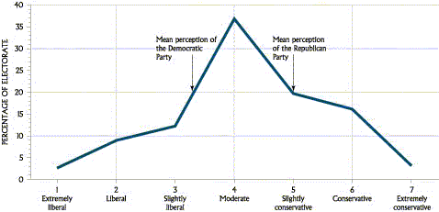
Distribution of Political Views
Most voters are “middle of the road” voters

Slide 7
Multiparty Systems
Advantages
Provides broader representation of the people.
More responsive to the will of the people.
Give voters more choices at the polls.
Disadvantages
Cause parties to form coalitions, which can dissolve easily.
Failure of coalitions can cause instability in government.

Slide 8
Party Membership Patterns
Factors that can influence party membership:
Family
Major Events
Economic Status
Religion
Occupation
Age

Slide 9
Why Minor Parties Are Important
Minor parties play several important roles:
“Spoiler Role”
Minor party candidates can pull decisive votes away from one of the major parties’ candidates, especially if the minor party candidate is from a splinter party. Ralph Nader had this effect in the 2000 election and probably cost Gore the election.
Critic
Minor parties, especially single-issue parties, often take stands on and draw attention to controversial issues.
Innovator
Often, minor parties will draw attention to important issues and propose innovative solutions to problems. If these proposals gain popular support, they are often integrated into the platforms of the two major parties.

Slide 10
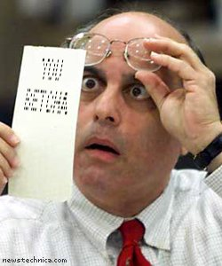
Hanging Chad

Slide 11
The Decentralized Nature of the Parties
Both of the major parties are highly decentralized and fragmented.
Why?
The party out of power lacks a strong leader.
The federal system distributes powers widely, in turn causing the parties to be decentralized.
The nominating process pits party members against one another because only one person can chosen to be the party’s presidential candidate.

Slide 12
National Party Machinery
All four elements of both major parties work together loosely to achieve the party’s goals.
The National Convention
The Congressional Campaign Committees
The National Chairperson
The National Committee

Slide 13
The Three Components of the Party
The Party in the Electorate Those who always or almost always vote for party candidates. The Voters and largest component of the party
The Party Organization: Those who run and control the party machinery. They work year-round to promote the party.
The Party in Government Those who hold office in the government and belong to that party.

Slide 14
The Future of Major Parties
Affiliation is weakening and party organizations are becoming less powerful.
For voters:
More people are unwilling to label themselves as “Democrats” or “Republicans”. The number of “independents” is increasing.
Split-ticket voting—voting for candidates of different parties for different offices at the same election
For candidate:
Changes in the technology of campaigning, especially the use of television and the Internet, have made candidates more independent of the party organization

Slide 15
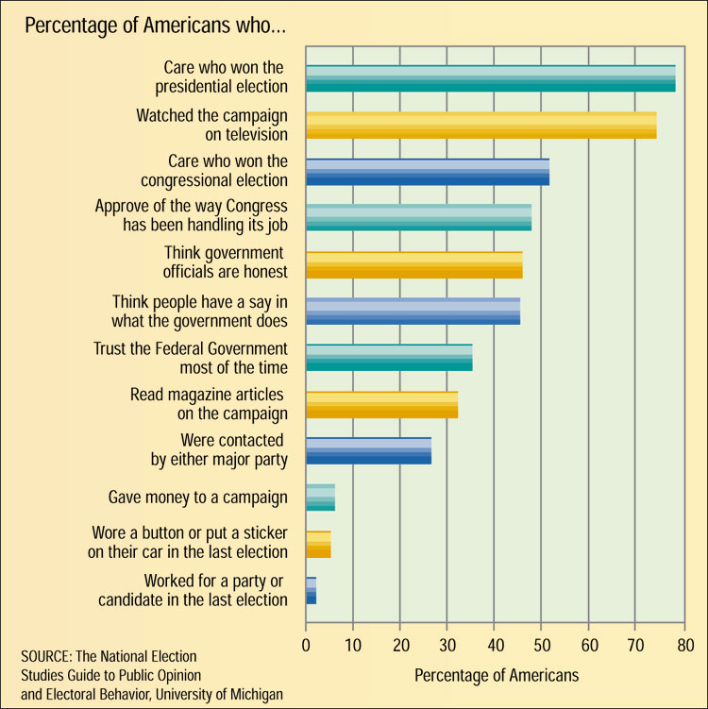
Political Participation and Awareness in America

Slide 16
Important Question Chapter 5
Why does the U.S. have a two party system?
How does a multiparty system differ from our two party system?
How can a Third Party impact the Democratic or Republican party?

Slide 17
Nonvoters (idiot)
Millions of Americans do not vote when elections are held.
Only 50.1 percent of eligible voters cast ballots in the 2000 presidential election, and only 46.3 percent of the electorate voted for the members of the House of Representatives.
Voter turnout significantly decreases in off-year elections, that is congressional elections held in years when there is no presidential election.

Slide 18
Why People Do Not Vote
Most nonvoters do not vote because
voting is in some way inconvenient,
they do not believe that their vote will make a difference, or
they distrust politics and political candidates.

Slide 19
Sociological Factors
Voter preferences can’t be predicted by just one sociological factor. Voter opinion is a combination of all of these factors and more.
Income and Occupation
Education
Gender and Age
Religious and Ethnic Background
Geography
Family and Other Groups

Slide 20
Psychological Factors
Voters’ perceptions of their party, the candidates, and the issues significantly affects their voting.
Party Identification
The loyalty of people to a particular political party is the single most significant and lasting predictor of how a person will vote.
Candidates and Issues
Candidates and issues are two short-term factors that can influence even the most loyal Democrat or Republican. People may vote out of their chosen party if they dislike a candidate or the party’s stand on a particular issue.

Slide 21
Why do some people not vote?
Generally speaking, who is most likely to be a Democrat; a Republican?

Slide 22
Chapter 7 Steps To Be Elected (President)
1. Announcing one’s candidacy or self announcement.
Gaining the nomination, in which the field of candidates is narrowed. Candidates campaign in:
Primaries (January – August) Funded by private contributions
Caucuses – meetings of party members to decide which candidate to support (who gets delegates)
3. Winning Nomination in August at the National Party Convention
4. General election, the regularly scheduled election in November where voters make the final choice of officeholder.

Slide 23
Types of Primaries
Closed Primary (New Mexico)
Only declared party members can
vote.
Open Primary (Texas)
Any qualified voter can take part.
Can select either Democrat or
Republican ballot
Blanket Primary
Qualified voters can vote for any
candidate, regardless of party
(can mix party choices)

Slide 24
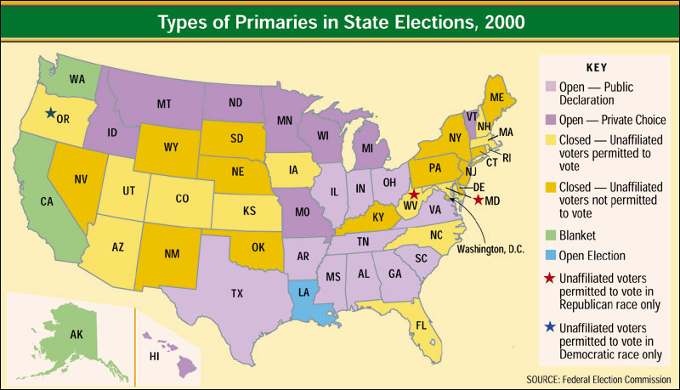
Primaries Across the United States
Types of primaries in State Elections, 2000

Slide 25
The National Convention
In July/August, the two major political parties hold their national convention.
Delegates gained in the caucuses and primaries cast their vote for the candidate of their choice
Party platform is developed
The party’s Presidential and Vice Presidential candidates are confirmed

Slide 26
The Administration of Elections
Elections are primarily regulated by State law, but there are some overreaching federal regulations.
Congress
Congress has the power to set the time, place, and manner of congressional and presidential elections.
Congress has chosen the first Tuesday after the first Monday in November of every even-numbered year for congressional elections, with the presidential election being held the same day every fourth year.
States
States determine the details of the election of thousands of State and local officials.
Most States provide for absentee voting, for voters who are unable to get to their regular polling places on election day. Some States within the last few years have started to allow voting a few days before election day to increase voter participation.

Slide 27
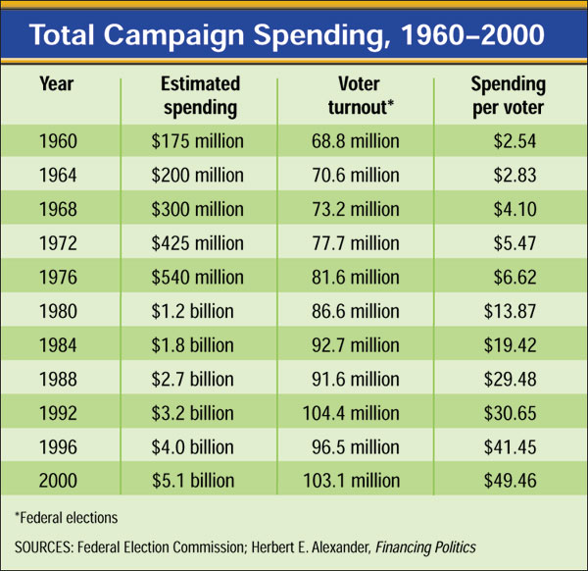
Money and Elections

Slide 28
Sources of Funding
Private and Public Sources of Campaign Money
Small contributors
Wealthy supporters
Candidates
Temporary fund-raising organizations
Nonparty groups such as PACs
(political action committees)
Government “matching funds”

Slide 29
Regulating Campaign Financing
The Federal Election Campaign Act (amendments) of 1974 was passed in response to the Watergate scandal
For Presidential elections
Created Federal Election Commission (FEC) – 6 bipartisan members serve on the FEC
Government provides matching funds
Limits campaign spending (if receiving federal matching funds)
Must disclose all contributions/expenditures
Limits contributions
Individuals may contribute $1,000 to a campaign
PACs may contribute $5,000 to a campaign
Individuals may contribute $20,000 to a political party’s national committee

Slide 30
The Federal Election Commission
The Federal Election Commission (FEC) enforces:
the timely disclosure of campaign finance information
limits on campaign contributions
limits on campaign expenditures
provisions for public funding of presidential campaigns

Slide 31
Political Action Committees (PACs)
Number of PACs greatly increased after passage of FECA in 1974 (to avoid the FECA requirements)
PACs are organizations designed to contributes funds to political campaigns and avoid FECA guidelines (For example, labor unions cannot contribute to campaigns but the Political Actions Committee for a steelworkers union can contribute)

Slide 32
Loopholes in the Law
“More loophole than law…” — Lyndon Johnson
Hard Money – money given directly to a candidates campaign
Soft money—money given to State and local party organizations for “party-building activities” that is filtered to presidential or congressional campaigns. $500 million was given to campaigns in this way in 2000.
Independent campaign spending—a person unrelated and unconnected to a candidate or party can spend as much money as they want to benefit or work against candidates. (like the “Swiftboat” ads against Kerry)
Issue ads—take a stand on certain issues in order to criticize or support a certain candidate without actually mentioning that person’s name.

