Slide 1
Chapter 20
Global Economic Challenges
LAST CHAPTER

Slide 2
Vocabulary Chapter 20
Free Trade Area
Life Expectancy
Capital Flight
European Union
Zero Population Growth
International Monetary Fund
Developing Country
External Debt
World Bank
Crude Birthrate
Default

Slide 3
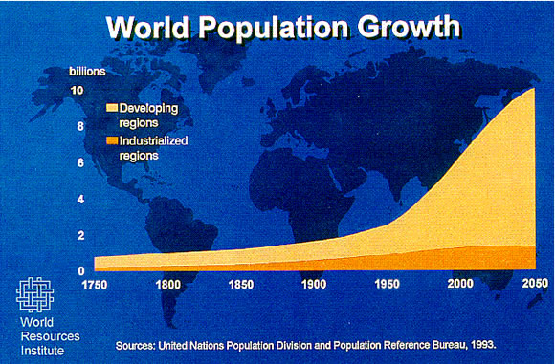
POPULATION Issues
Thomas Malthus
1798 wrote and Essay on the Principles of Population
Trends of growth at 1.4%

Slide 4
Nonrenewable energy resources
Oil
1973 Embargo = oil was $5 to more than $35 a barrel
1995 prices were below $9 a barrel
Natural Gas
Coal
two-thirds of the reserves are in US, Russia, and China
Nuclear Energy
Cost to build
Hazardous byproducts

Slide 5
Renewable energy resources
Hydroelectric Power
Biomass
Solar Energy
Wind Power

Slide 6
Pollution and Economic incentives
Lower Production Cost
Waste-Disposal System
Solutions
Standards
Taxes
Permits

Slide 7
Decision Making
Problem
Reasoned Approach
5 Steps
Cost Benefit Analysis
Personal or social goals
Alternatives to meeting the goal
Use Economic Concepts to understand the problem
Decide which alternative is the best

Slide 8
Important Question Chapter 17
Why do countries trade?
Why does the total world output of goods increase as countries specialize and trade?
List and explain the reasons that restrict trade. What are the main arguments to restrict trade? Which are the 2 legitimate reasons?
Explain how a currency appreciates and depreciates. How does changes in value affect a countries exports and imports?
What is the most favored nation clause and why do US trading partners want this designation?

Slide 9
Important Questions CH 20
What did Thomas Malthus predict would happen in his essay he wrote in 1798?
What are the forms of renewable resources and nonrenewable resources?
How did the US use legislated standards and pollution taxes to reduce the overall pollution to the world?

Slide 10
1. 100*1.83=183
183-120=63
63*.55=34.65

