Slide 1
Chap 4-5 Demand and Supply
Chapter 4: Pg 89 – 107
Chapter 5: Pg 113 - 120

Slide 2
Vocabulary Chap 4 - 5
Microeconomics
Law of Demand
Marginal Utility
Diminishing Marginal Utility
Change in Quantity Demanded
Change in Demand
Substitute
Complementary
Elasticity
Law of Supply
Subsidy
Income Effect

Slide 3
The Individual Demand Curve and the Law of Demand
Al’s Demand Schedule for Pizza
Price |  | Quantity of pizzas per month
$2 |  | 13
4 |  | 10
6 |  | 7
8 |  | 4
10 |  | 1
The demand schedule is a table that shows the relationship between price and quantity demanded by an individual consumer.

Slide 4
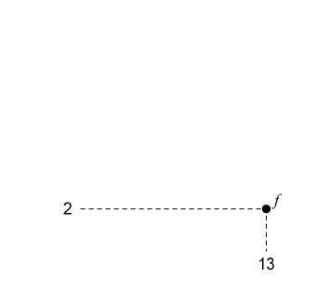
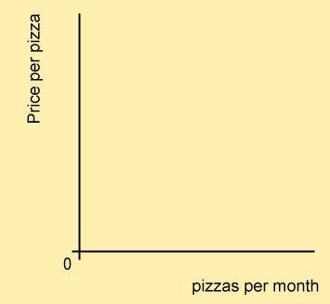
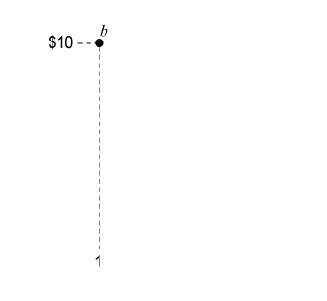
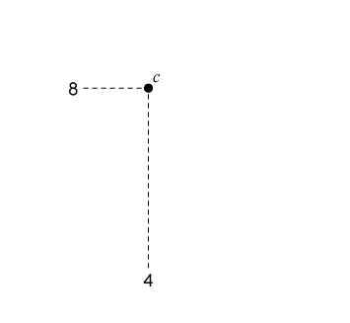
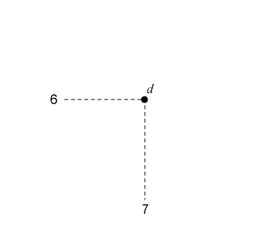
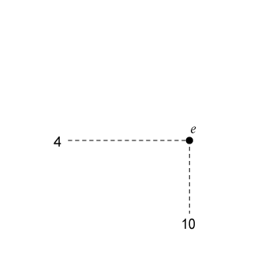
The Individual Demand Curve and the Law of Demand
The individual demand curve is a graphical representation of the demand schedule for an individual.
The market demand curve is a representation of the total individual demand schedules.
LAW OF DEMAND: The higher the price,
the smaller the quantity demanded; the lower
the price, the larger the quantity demanded.

Slide 5
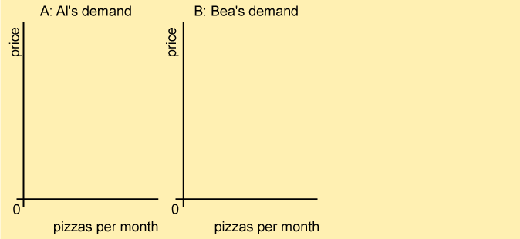
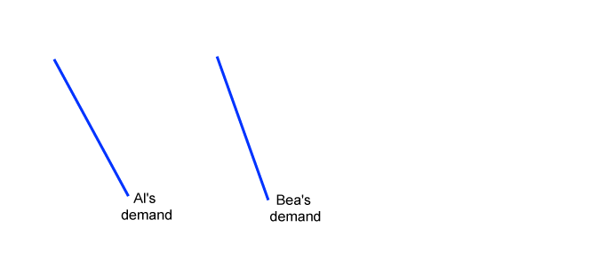
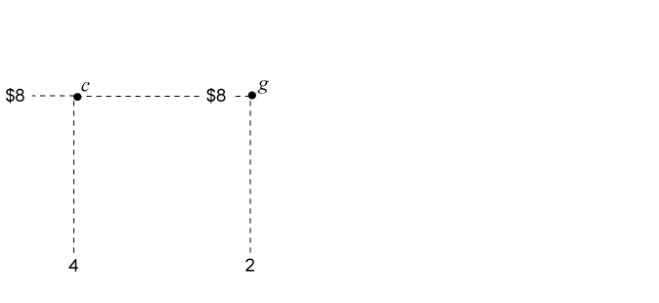
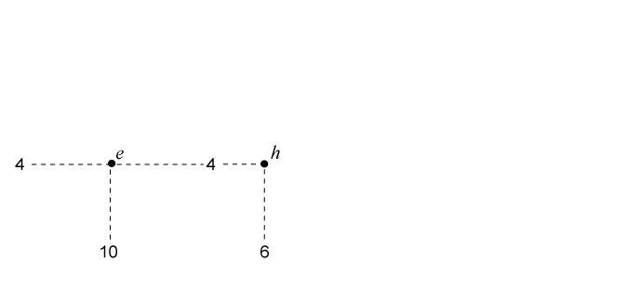
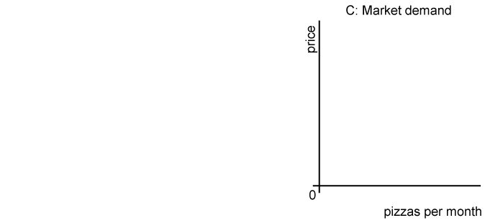
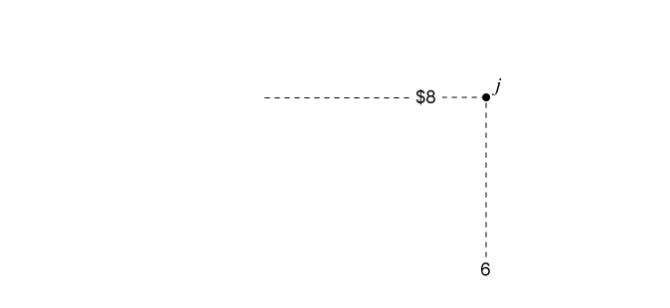
From Individual to Market Demand
The market demand curve shows the relationship between price and quantity demanded by all consumers together.

Slide 6
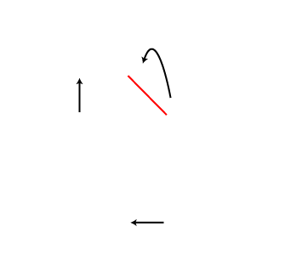
The Demand Curve and the Law of Demand
Quantity demanded is the amount of a good an individual consumer or consumers as a group are willing to buy.
A change in quantity demanded is a change in the amount of a good demanded resulting from a change in the price of the good.
In this case, an increase in price causes a decrease in quantity demanded, and a movement upward along the individual’s demand curve.

Slide 7
Determinants of Demand (Why the Demand Curve is downsloping)
Law of Diminishing Marginal Utility suggests that we receive less satisfaction from additional units that we may purchase.
The substitution effect is the change in consumption resulting from a change in the price of one good relative to the price of other goods.

Slide 8
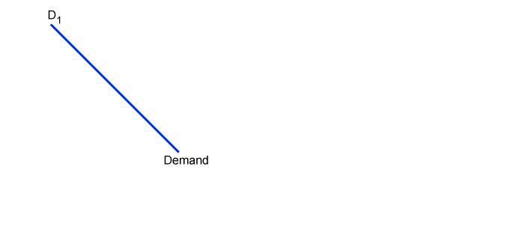
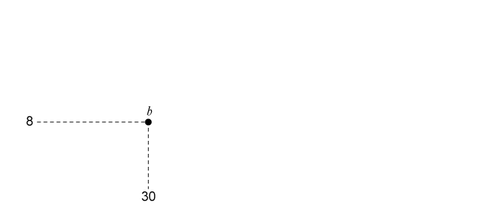
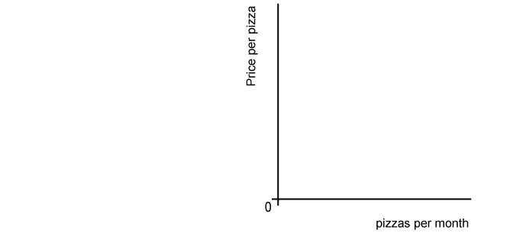
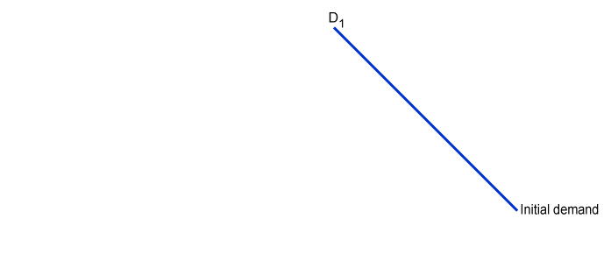
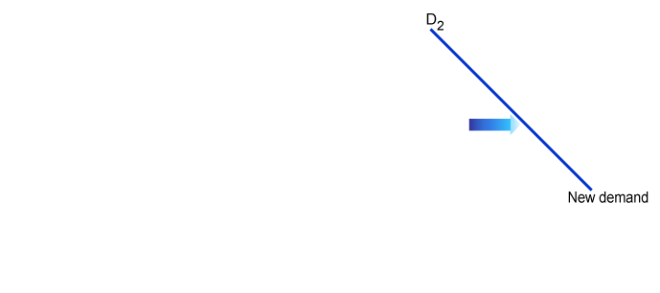
Market Effects of Changes in Demand
Change in Quantity Demanded versus Change in Demand
A change in price causes a change in quantity demanded.
A change in demand
causes a shift of the entire demand curve.

Slide 9
Causes of an Increase in Demand (a shift of Demand)
An increase in demand can occur for several reasons:
An increase in income allows a consumer to buy more; likewise a decrease in come causes a consumer to buy less.
Consumer tastes can be affected positively by advertising, trends, etc. Tastes can also cause a decrease in demand if adverse news is delivered.

Slide 10
Causes of an Increase in Demand (Continued)
An increase in the price of a substitute good. When two goods are substitutes, an increase in the price of one good increases the demand for the other good.
A decrease in the price of a complementary good. Two goods are complements when an increase in the price of one good decreases the demand for the other good.

Slide 11
Causes of an Increase in Demand (Continued)
Other causes
An increase in population/number of buyers
Expectations of higher future prices

Slide 12
Elasticity of Demand
Demand elasticity – the extent to which a change in price causes a change in the quantity demanded.
Elastic demand is a condition in which a price change causes a large change in demand.
Inelastic demand is a condition in which a price change causes a small change in demand.

Slide 13
What Determines Demand Elasticity
Can the purchase be delayed?
Is it a prescription drug or is it a vegetable that would be nice to eat.
Are adequate substitutes available?
If the price of beef rises, can we eat chicken instead?
Does the purchase use a large portion of income?
A visit to the doctor might be delayed if our income does not budget for the visit.

Slide 14
What is Supply?
Supply is the amount of a product that would be offered for sale at all possible prices.
Law of Supply states that suppliers offer more product at higher prices and less product at lower prices.

Slide 15
The Individual Supply Curve
Nora’s Pizzeria Schedule for Pizza
Price |  | Quantity of pizzas per month
$4 |  | 100
6 |  | 200
8 |  | 300
10 |  | 400
12 |  | 500
A firm’s supply schedule is a table that shows the relationship between price and quantity supplied.

Slide 16
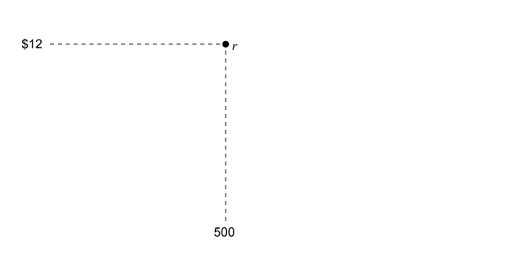
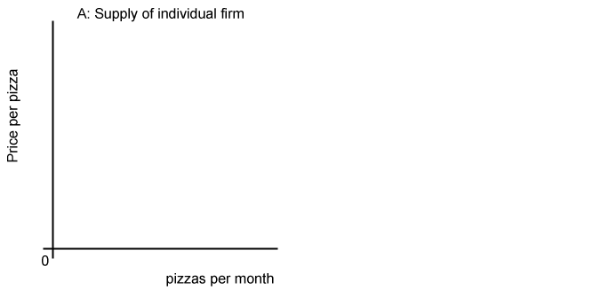
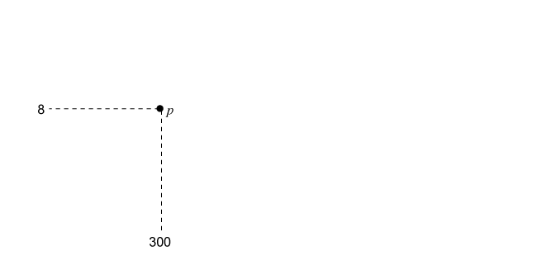
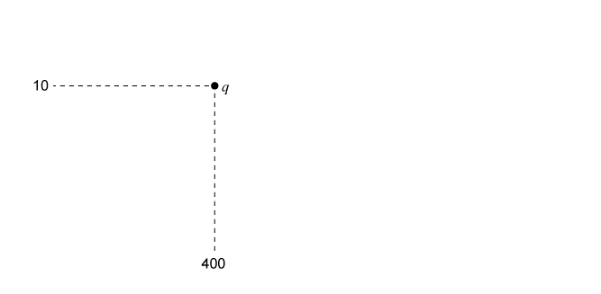
The Supply Curve for Nora’s Pizzeria
The supply curve is a graphical representation of the supply schedule. Its positive slope reflects the law of supply.

Slide 17
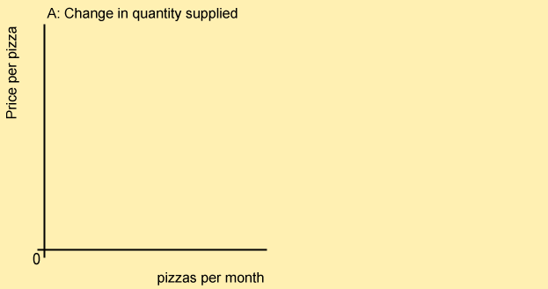
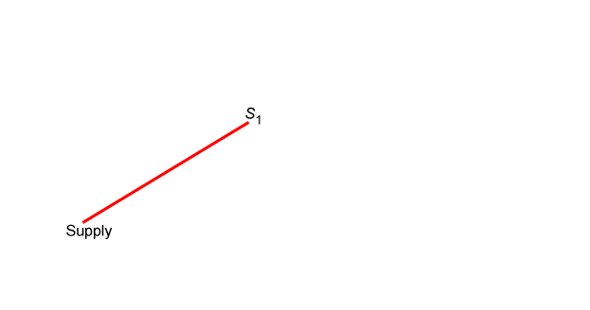
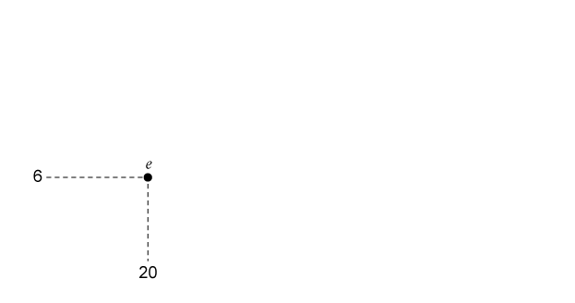
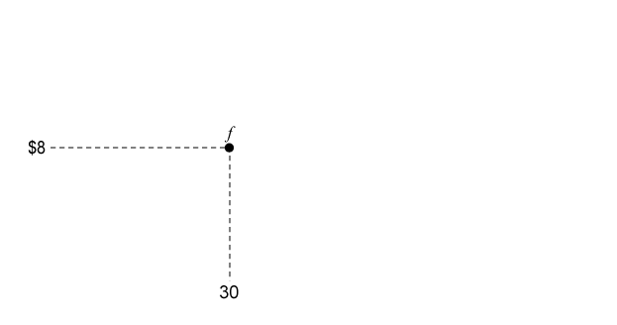
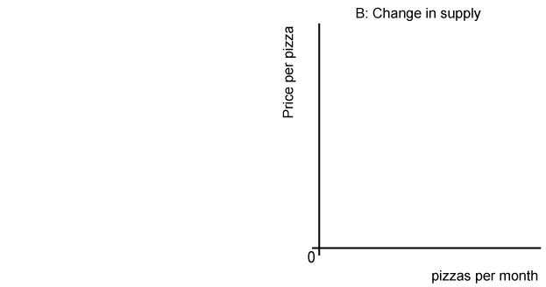
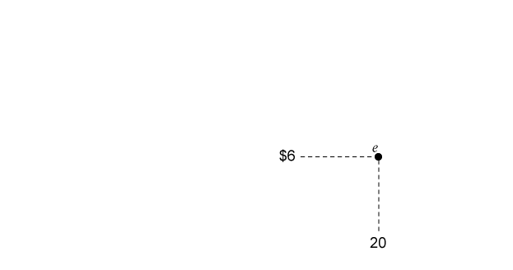
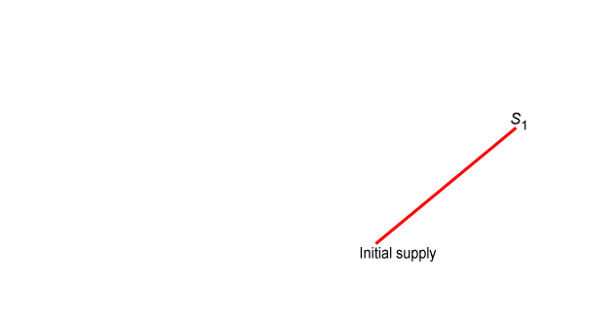
Effects of Changes in Supply
Change in Quantity Supplied versus Change in Supply
A change in price causes a change in quantity supplied.
A change in supply shifts the entire supply curve.

Slide 18
Causes of a Change in Supply
A change in supply can occur for several reasons:
An increase in input costs decreases supply; and a decrease in input costs increases supply.
An increase in productivity or new technologies causes supply to increase
An increase in the number of sellers.
Expectations of a future change in prices.
A change in taxes or subsidies or a change in government regulations

Slide 19
Elasticity of Supply
Supply elasticity is how the quantity supplied responds to a price change.
Production decisions relate to whether supply is elastic or inelastic, as opposed to elasticity in demand.
If a firm can adjust to new prices quickly, supply will be elastic
If increased production requires large investment of capital, the price will be inelastic.

Slide 20
Chapter 4,5 Important Questions
What is the difference between a change in demand, and a change in quantity demanded?
Cite some reasons why demand changes.
Describe the concept of demand elasticity. Give examples.
What are some of the determinants of demand elasticity?
What does the Law of Supply state?
Why does supply change?

